Slide 1
User Interface Design
Instructor:

Slide 2
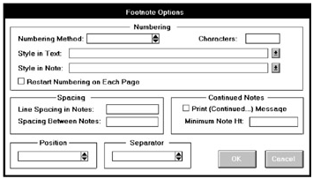
Problem 7

Slide 3
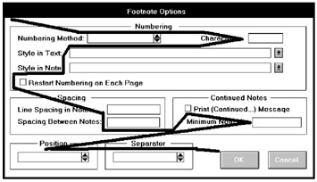
Problem 7

Slide 4
Problem 7
is poor alignment of controls
The standalone check boxes tend to get lost
The Position and Separator control borders are placed around single elements. This is not recommended but it does help to provide screen balance, which is quite good

Slide 5
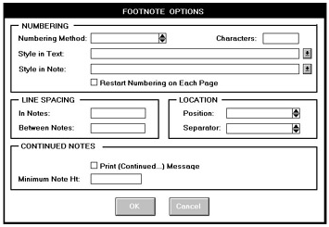
Solution 7

Slide 6
Solution 7
Elements are aligned, including the single check boxes
Headings are capitalized and left-justified within the borders
“Position” and “Separator” are combined into one grouping called “LOCATION”

Slide 7
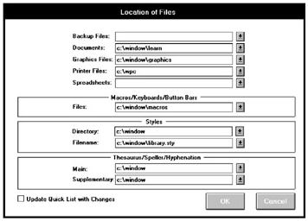
Problem 8

Slide 8
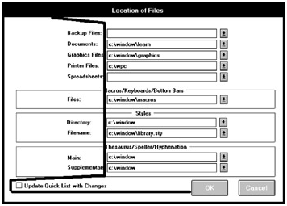
Problem 8

Slide 9
Problem 8
Note the improved alignment of this screen's controls. It is excellent, except for the single check box in the lower-left corner. Again, this check box can get lost here
a group box around the top five controls should also be included.

Slide 10
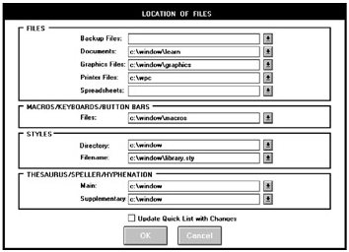
Solution 8

Slide 11
Solution 8
The redesigned LOCATION OF FILES screen. The section headings are capitalized and left-justified in the borders.
Visual competition with the text box information is now minimized
A grouping called FILES is created at the screen’s top for consistency and balance
The single check box is aligned under the text boxes.

Slide 12
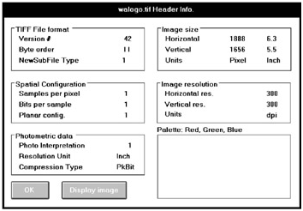
Problem 9

Slide 13
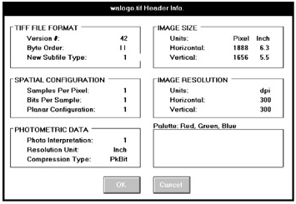
Solution 9

Slide 14
Solution 9
Headings are capitalized to set them off from the control captions
The headline style of presentation is consistently applied to all captions.
The data fields are aligned and the Units in the IMAGE sections are moved to the top

Slide 15
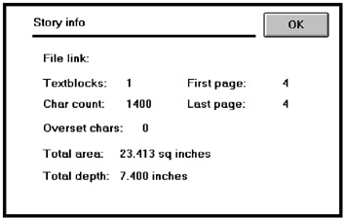
Problem 10

Slide 16
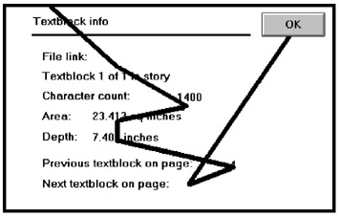
Problem 10

Slide 17
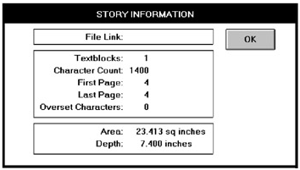
Solution 10 - 1

Slide 18
Solution 10 - 1
Elements are aligned and incorporated within borders
Note that headings are not included within the borders
The command remains positioned in the upper-right corner, as is standard for this graphical system.

Slide 19
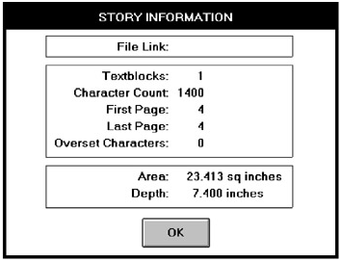
Solution 10 - 2

Slide 20
Solution 10 - 2
Then only difference is that the command button is positioned at the bottom rather than at the side, creating a better balanced screen.

Slide 21


